Slide 1
Smoking Trends in the United States
By:
Stephanie Gedvilas
Stephanie Klauke
Jackie Ortega

Slide 2
Overview
Section I: Who Smokes?
  Smoking demographics
Section II: Smoking by Education and Income
Section III: Health Effects of Smoking
Section IV: Conclusion

Slide 3
Who Smokes?
According to the CDC (Center for Disease Control), 46.2 million US adults were smokers in 2001.
This was 22.8% of all adults, which means that nearly 1 in every 4 people smoked.
More recently in 2003, 70.8 million people use some sort of Tobacco product.

Slide 4
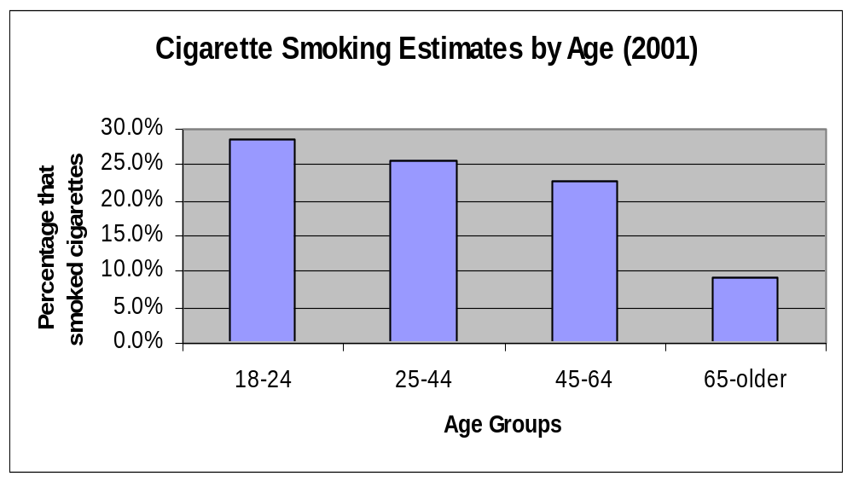
Cigarette Smoking Estimates by Age for 2001

Slide 5
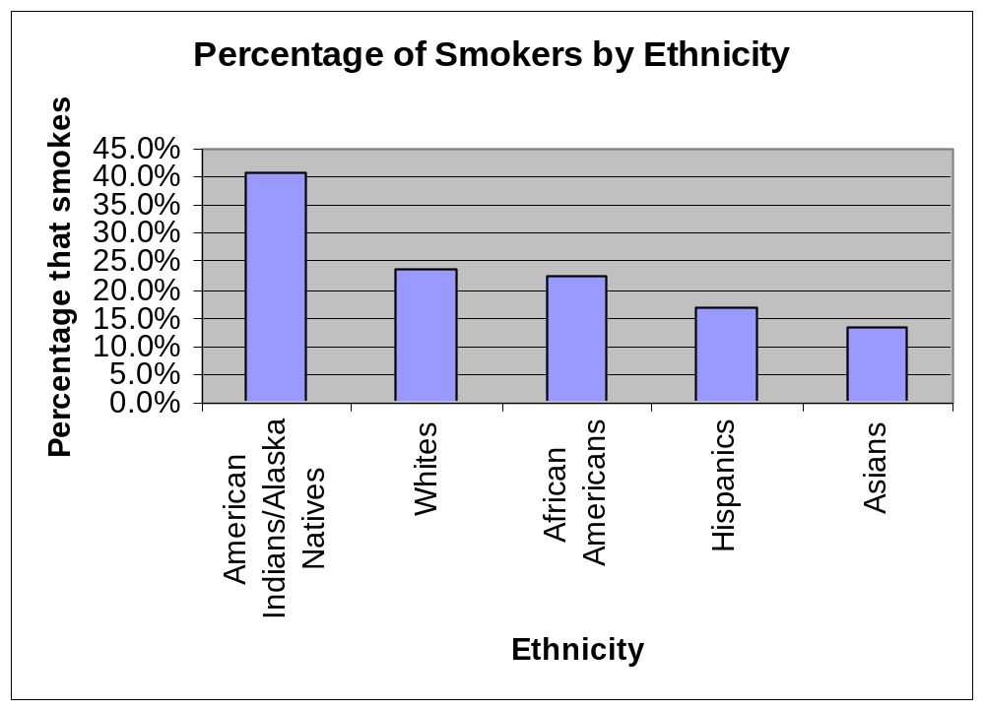
Percentage of Smokers by Ethnicity

Slide 6
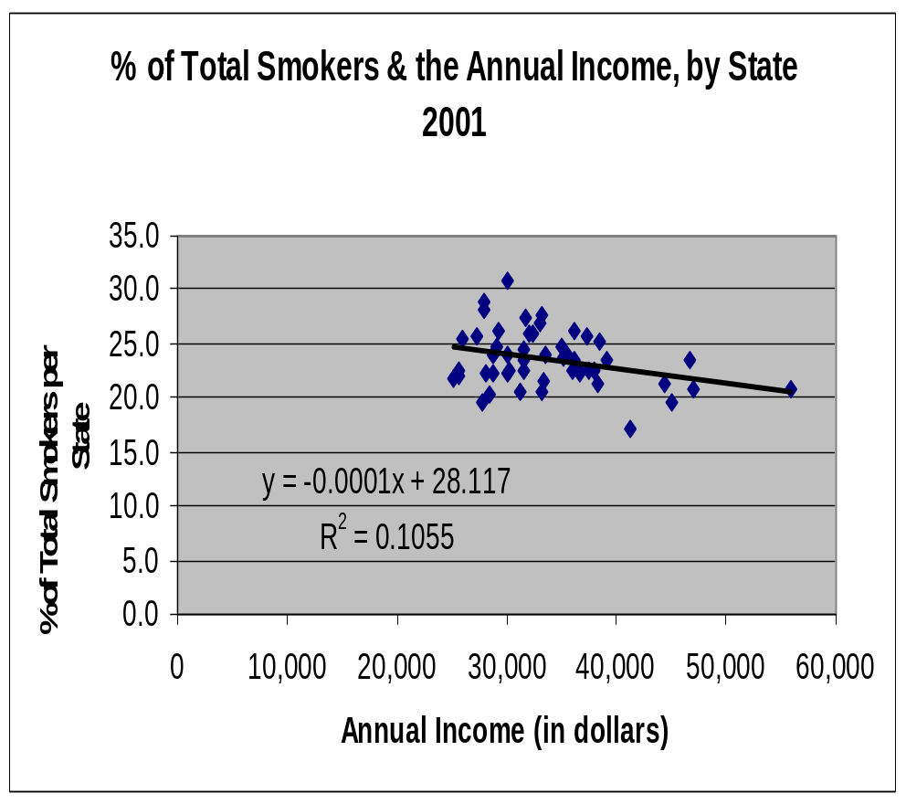
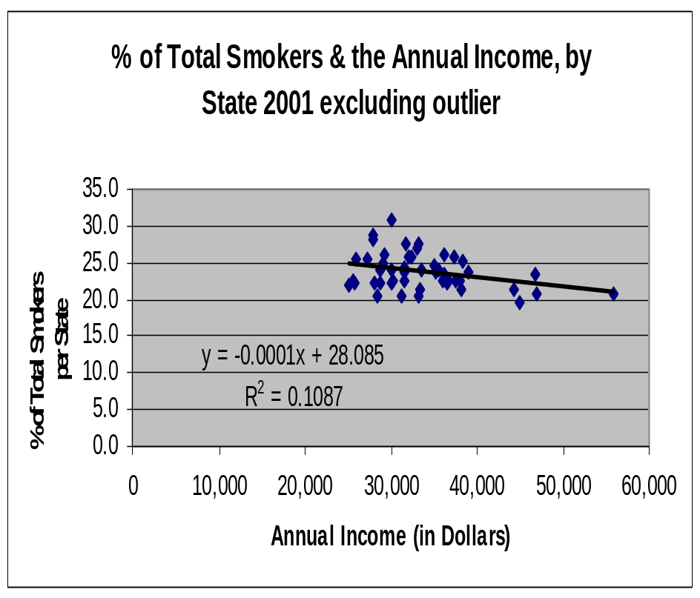
Smokers and Income by State

Slide 7
Percentage of Total Smokers & Annual Income
This graph represents the percentage of total smokers by state, and their annual income. The state that had the highest percentage of smokers was Kentucky with 30.9%, and Utah was the lowest with 13.3%.
There is no correlation in this graph. But we found that r value is 0.325, without the outlier. The critical value needed to be 95% confident needed was 0.279. Therefore, we are 95% confident there is a correlation when there is no outlier.

Slide 8
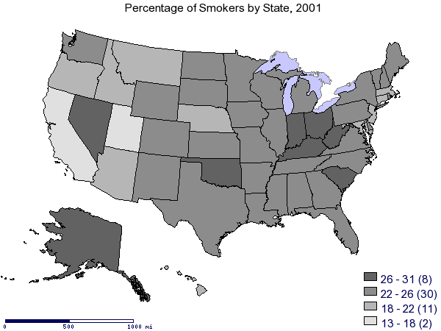
Map of Percentage of Smokers by State

Slide 9
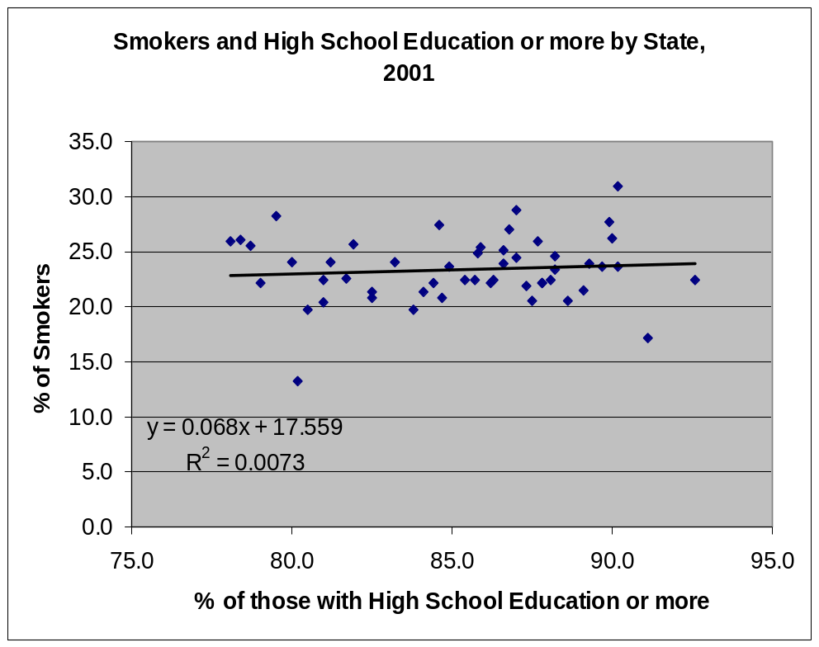
Smoking and Level of Education
This graph shows the relationship between smokers and the level of education by state.
We found that there was no direct correlation between a person’s level of education and the percentage of smokers. The r value is 0.086, the critical value needed was 0.279. Therefore, there was no correlation.

Slide 10
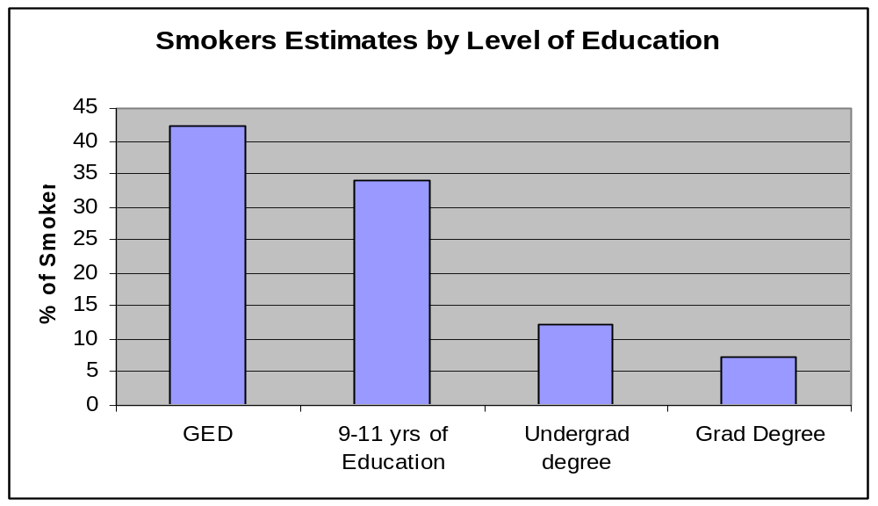
Graph of level of Education

Slide 11
Health Effects of Smoking
Each year, 440,000 people die in the United States from tobacco use.
Smoking is the most preventable cause of premature death in our society.
It’s effects can range from cancer to high blood pressure, heart disease, low birth rate among pregnant women who smoke, and emphysema.

Slide 12
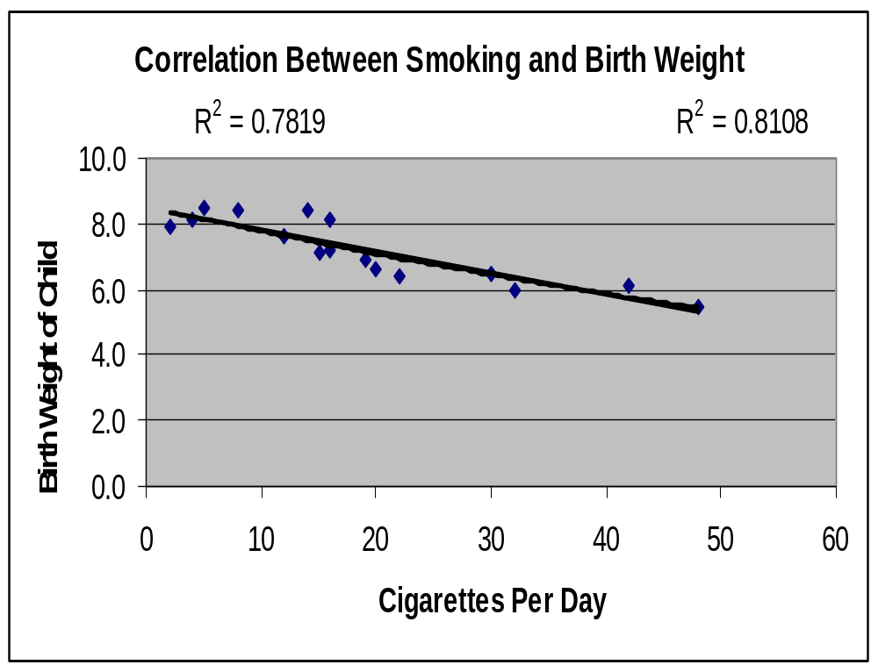
Correlation Between Smoking and Birth Weight
As one can see there is a correlation between the number of cigarettes a woman has per day to the birth weight of her child.
In order to be 99% confident value one needed a .623 on the critical value chart. We found that the correlation coefficient was .884. Therefore, one can see that there is a direct correlation between the number of cigarettes a woman smokes per day and the birth weight of her baby.

Slide 13
Smoking in Association with Drug and Alcohol Use
Research has found that those who smoke cigarettes were more likely to use other tobacco products, alcohol, and drugs.
Those who smoke are found to drink more excessively.
Research has found that 4.2% of non-smokers are drug users, whereas 19.8% of smokers are drug users.

Slide 14
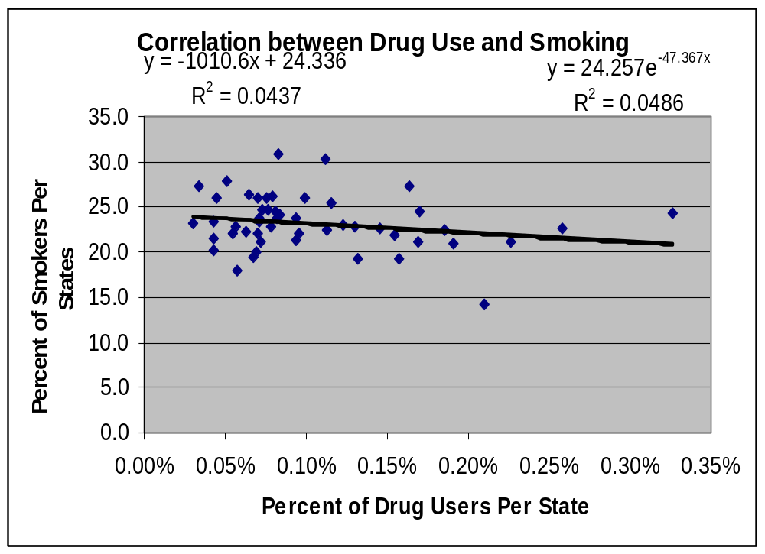
Correlation Between Drug Use and Smoking

Slide 15
Is It Beneficial to Stop Smoking?
Research has found:
  After 24 hours: Your chance of a heart attack decreases.
  After 3 months: Your circulation improves and your lung function increases up to 30%.
  In 1 to 9 months: Coughing, sinus congestion, fatigue, and shortness of breath decrease. Cilia regain normal function in the lungs.
  After 1 year: The excess risk of coronary heart disease is half that of a smokers
  After 10 years: The lung cancer death rate is about half that of a continuing smoker’s. The risk of caner of the mouth, throat, esophagus, bladder, kidney, and pancreas decrease.
  After 15 years: The risk of coronary heart disease is that of a nonsmoker’s.
  Note: It is important to note that the extent to which these risks decrease depends on how much the person smoked, the age the person started smoking, and the amount of inhalation.

Slide 16
Conclusion
We found a correlation between the states income and the percentage of smokers.
There was no strong correlation between an individuals education and the percentage of smokers.
From the graphs we believe there is a correlation between smoking and drug use.
Finally, there is a strong correlation between birth weight and the number of cigarettes a pregnant woman smoked per day.
In order to lower the number of smokers in the states, with lower incomes and higher percentages of smokers, we feel that the government should have some type of educational program directed at these areas.
Also, if the government were to produce educational materials that were distributed in schools, the number of smokers between the ages of 18-24 may be reduced.
In general the government should take a more active role in educating the public on the effects of smoking.

